Slide 1


Attention Restoration Theory - how does time influence the outcome?

Slide 2
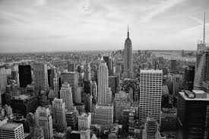

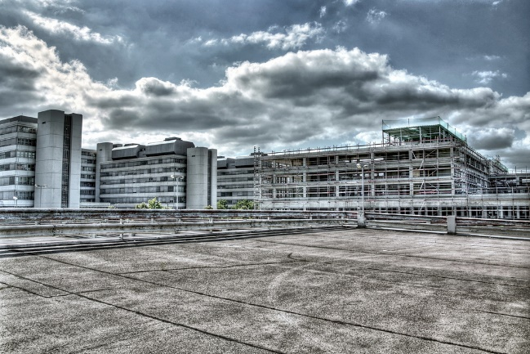
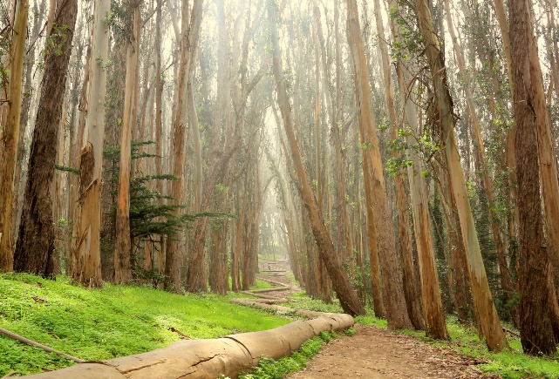
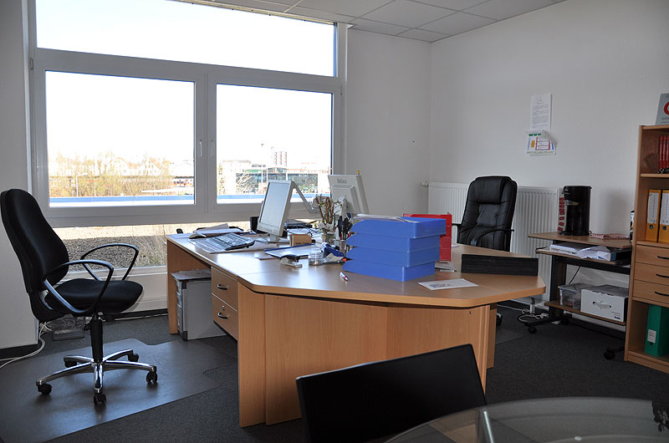
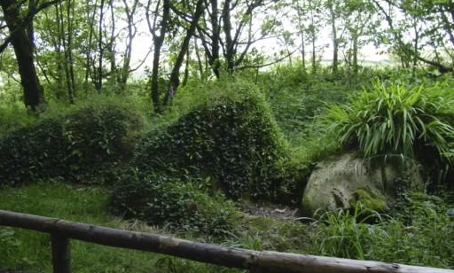
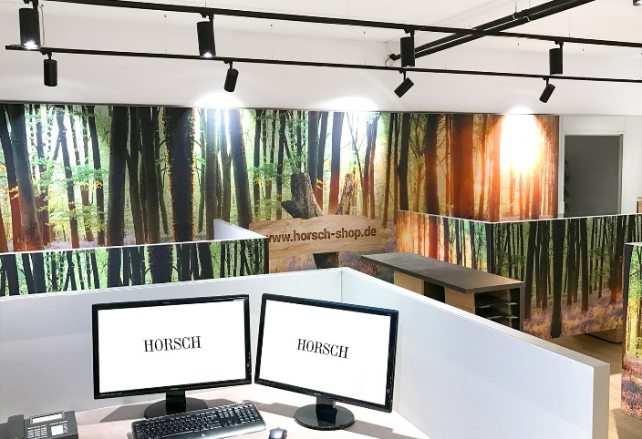
Back to Nature
Project Review and Feedback
Research Practicum
IDS6916
Andres Hanchi
Markus Loennig
Marc Mailloux

Slide 3
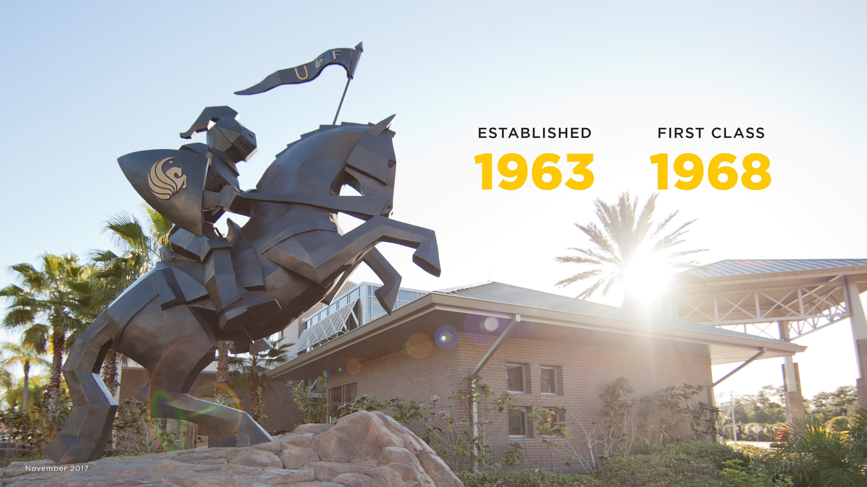
Content:
- Topic / Purpose Statement
- Introduction
- Literature Review / Related Works
- Research Question
- Research Methods
- Hypothesis
- Preliminary Framework / Setup
- Plan of Attack / Deliverables

Slide 4
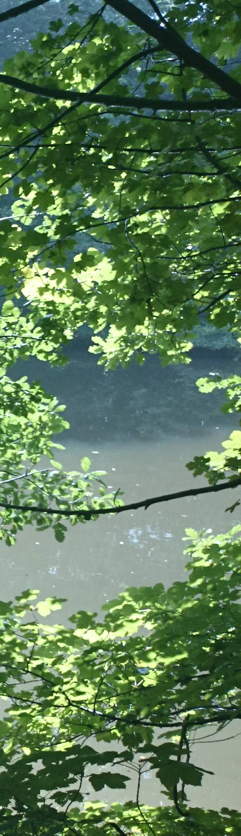
Topic / Purpose Statement
Studies on Attention Restoration Theory (ART) has shown positive effects that Nature can have on attention restoration
But: researchers arbitrarily decided the length of exposure time (usually 15 minutes or more)
Our goal:
study the length needed to show measurable effects of Nature exposure through Virtual Reality (VR)
Notes:
Our goal is to restore one’s attention in less than the standard 15 minutes used in previous studies.

Slide 5
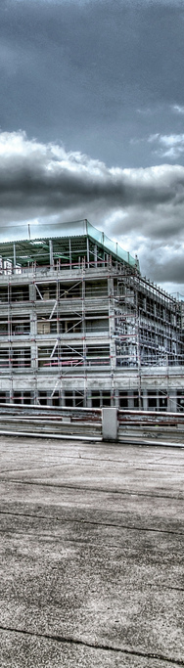
Introduction
Today’s fast pace can have a negative effect on attention
Directed attention is important for productivity and mental stability
Several studies based on ART have validated the positive effects that nature and/or nature scene exposure can have on one’s attention and its restoration.
Notes:
Understanding the time needed to restore attention is vital

Slide 6
Related Works / Literature Review
1995 Kaplan
differentiates stress and attention
integrated theory of stress permitting a significant role for attention
both benefit from restorative experiences
2016 Ohly, White, Wheeler, Bethel et al
Systematic review of ART potential
31 studies on ART and its effects
Study highlights diversity in methods and results of restorative experience

Slide 7
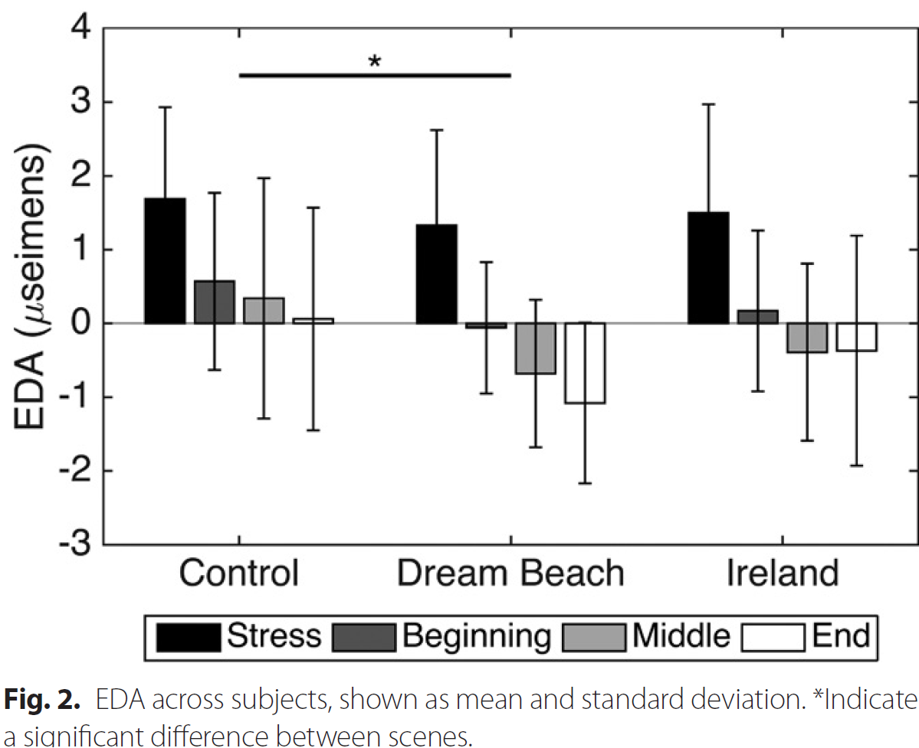
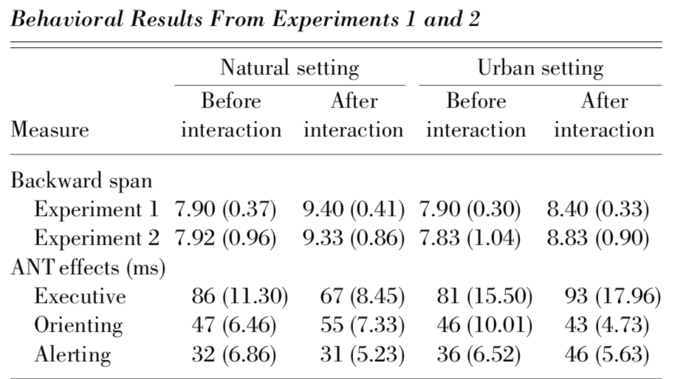
Related Works / Literature Review
2017 A. Anderson
effects of VR nature exposure on stress
2 experiments
Experiments provided different results due to participants perception of stress
2008 M. Berman
effects of nature/urban exposure on attention
2 experiments
Experiments provided validation of ART with nature / viewing nature by photos

Slide 8

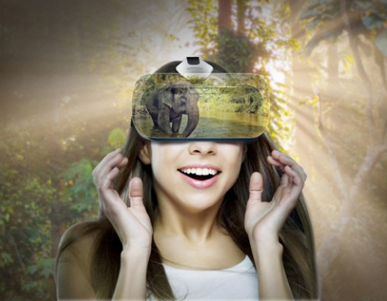
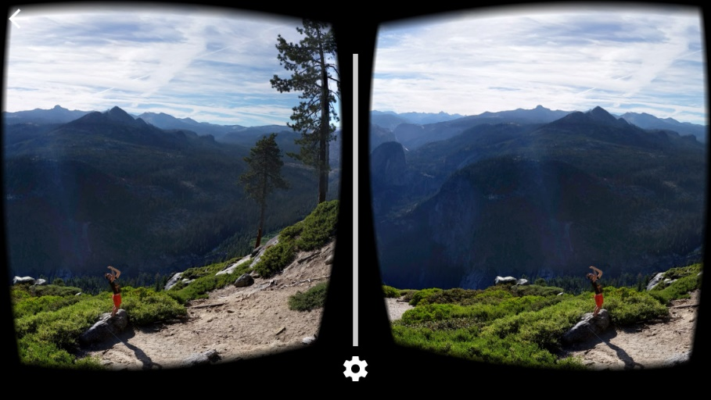
Research Question
Can we measure positives effects for attention restoration on individuals exposed to nature scenes delivered through Virtual Reality at 10 or less minutes?
Notes:
Based on the results from studies conducted on Attention Restoration Theory
These studies, exposed participnats to nature scenes using random lengths of time
Our research question is:

Slide 9

Research Method
For this study our group will conduct an experiment
A combination of surveys and interactive test will be administered to assess attention
Quantitative data will be gathered and analysed

Slide 10
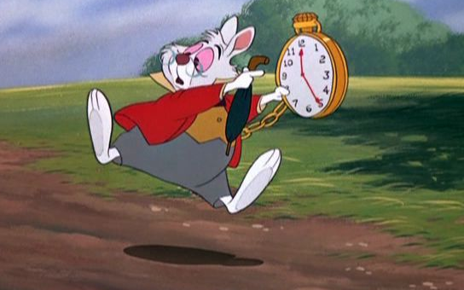
Hypothesis
Exposure to nature scenes through VR can measurably
restore one’s attention in less than 15 minutes

Slide 11
Preliminary Framework / Setup
PANAS | DSSQ | 2-Back test | Vigilance tasks | PANAS | 2-Back test | VR Session | 2-Back test | PANAS | DSSQ
Emotional baseline |  | Cognitive baseline | Attention depletion | Emotional state | Cognitive performance | Restoration | Cognitive performance | Emotional state
4 min
8 min
30 min
1 min
8 min
15 min
8 min
4 min
10 min
8 min
none

Slide 12
Preliminary Framework / Setup
The participants will be provided
PANAS (Positive And Negative Affect Schedule) and
DSSQ (Dundee Stress State Questionnaire)
to assess mood, anxiety and subjective stress levels
Then the 2-Back test be administered
to establish the baseline of cognitive performance / “concentration“
It is a continuous performance task to assess and measure working memory and working memory capacity
PANAS | DSSQ | 2-Back test | Vigilance tasks | PANAS | 2-Back test | VR Session | 2-Back test | PANAS | DSSQ

Slide 13
Preliminary Framework / Setup
Participants will take vigilance tasks
→ To deplete attentive/cognitive resources
PANAS assessment will be conducted again
change in affection
The 2-Back test will be administered again
→ Measurement of attention depletion
Exposure to nature scenes provided by a VR headset
→ Different length, for restoration of attentive resources
PANAS | DSSQ | 2-Back test | Vigilance tasks | PANAS | 2-Back test | VR Session | 2-Back test | PANAS | DSSQ

Slide 14
Preliminary Framework / Setup
2-Back test will be administered again
Measurement of restoration through VR Nature experience
Results need to be higher after VR session
The participants will be provided
PANAS and
DSSQ to assess mood and anxiety
→ Possible confounding variables?
PANAS | DSSQ | 2-Back test | Vigilance tasks | PANAS | 2-Back test | VR Session | 2-Back test | PANAS | DSSQ

Slide 15

Preliminary Framework / Setup
The experiment will be conducted
1 week apart with the same participants using different time intervals
Qualtrics will be used to record responses and transform data into excel like format
Data Analysis will be conducted using R-software
Hardware used will be a PC and the VR glasses Oculus Go
Notes:
Data will be analysed against expected results from Hypothesis.

Slide 16
Plan of Attack / Rough Deliverables
The VR headset has been allocated
The software used for the VR nature scenes has been identified
PANAS and DDSQ forms have been downloaded
Access to 2-Back test and Vigilance task test is being worked on.
Next is to start narrowing down the selection of participants
Identify the location of the experiment
Begin 1st experiment: Friday November 2nd (tbc)
Delivery of Results → 1st week of December (tbc)

Slide 17

Questions ?

